Slide 1
Dynamics
Forces and Net Force in 2- Dimensions

Slide 2

Question 1:
Three students are pushing a stalled car. Student A pushes on the back of the car with a force of
50 N East. Students B and C each push with forces of 60 N East either side of the car. There is a frictional force of 170 N West on the car. The car is:
  At rest.
  Moving forward and gaining speed.
  Moving forward at constant speed.
  Either I or III.

Slide 3
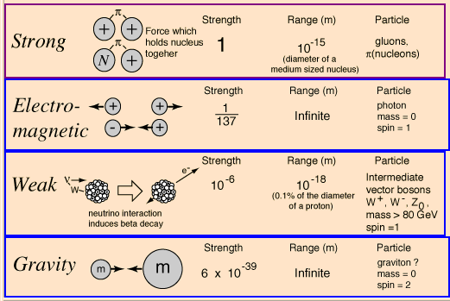
Dynamics
The study of motion including the forces involved in motion.
A force is a push or a pull.
The Fundamental Forces

Slide 4
The Search for Unification of Forces
Electricity
Electromagnetism
Maxwell, 1865
Magnetism
Electromagnetism
Electroweak Theory
1970’s
Weak Nuclear
Strong Nuclear?
Gravity???
Elegant Universe
Gravity the odd man out

Slide 5
Common Forces
• Force of Gravity due to Earth- F_{g}
• Normal Force-F_{n}
• Frictional Forces-F_{f}- general friction
F_{k}-kinetic friction
F_{s} –static friction
• Force of tension-F_{t}
• Force of air resistance-F_{air}
• Applied force-F_{app}

Slide 6
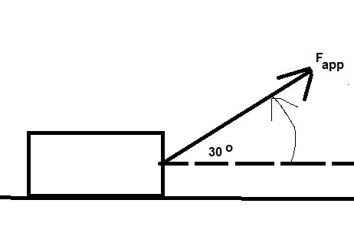
FREE BODY DIAGRAMS (FBD)
• Forces are vectors
FBD diagrams show all forces acting on ONE object
• Choose an appropriate coordinate system
Example: Draw an FBD for sled pulled along flat rough surface using a rope inclined at an angle of 30 ° to the horizontal.

Slide 7
2D Force Analysis
Find the acceleration of a sled is pulled along flat rough surface using a rope inclined at an angle of 30 ° to the horizontal given…
Mass of sled = 10.0 kg
Applied Force = 200.0 N
Coefficient of Friction = 0.730

Slide 8
FREE BODY DIAGRAMS (FBD)
• Forces are vectors
FBD diagrams show all forces acting on ONE object
• Choose an appropriate coordinate system
Example: Draw an FBD for a block sliding down on a ROUGH inclined plane.
Direction of Possible Motion

Slide 9
Homework:
Worksheet-FBD diagrams
Section 2.1 pg 62-64
Text Questions P1-3 pg. 65

